Slide 1
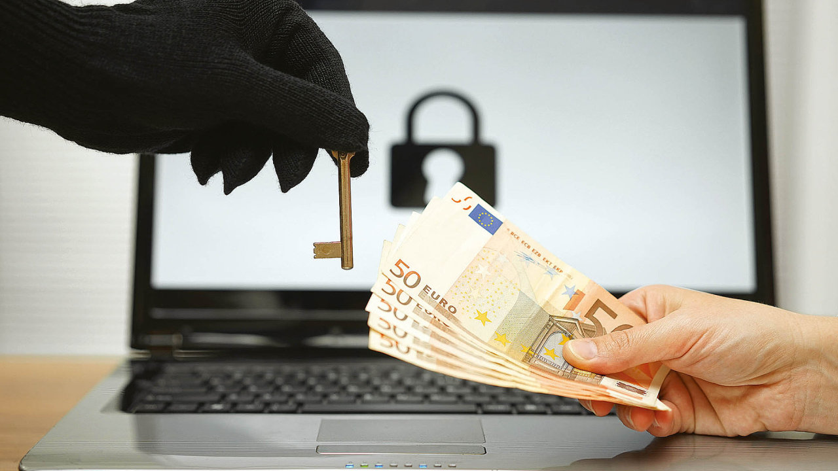
RANSOMWARE
PRESENTED BY : UMER GULZAR
Student at Dept. of CSE
SSM College of Engg & technology

Slide 2
OUTLINE
INTRODUCTION
WHAT IS RANSOMWARE
HOW IT WORKS
TYPES OF RANSOMWARE
FAMOUS RANSOMWARE
CONCLUSION

Slide 3
INTRODUCTION
CYBER EXTORTION
Cyber extortion is an online crime involving an attack or thread of attack against an enterprise, coupled with a demand for money to stop the attack

Slide 4
WHAT IS RANSOMWARE
Ransomware is a type of malware that essentially takes over a computer and prevents users from accessing data on it until a ransom is paid.
Ransomware usually locks computer,encrypts the data on it and prevents other software and apps from running.

Slide 5
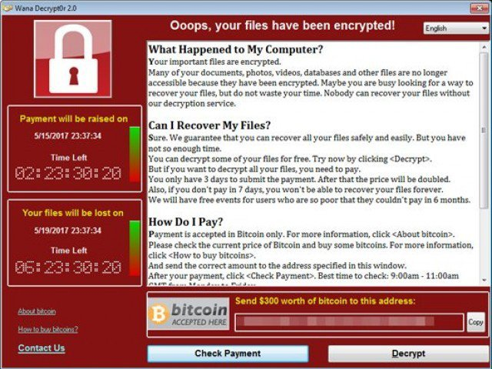

Slide 6
working
First the URL is send to the victim through different means like social media or by creating fake websites
The link opens a browser window and directs the user to a website that seems legitimate
Upon loading the page, the web server hosting the exploit kit begins communicating with the victims machine
Vulnerability is confirmed
The attacker also searches files with specific extensions and encrypts them
After encrypting the victim’s files, the malware sends the key to control server
The server then sends message to victim asking for money

Slide 7
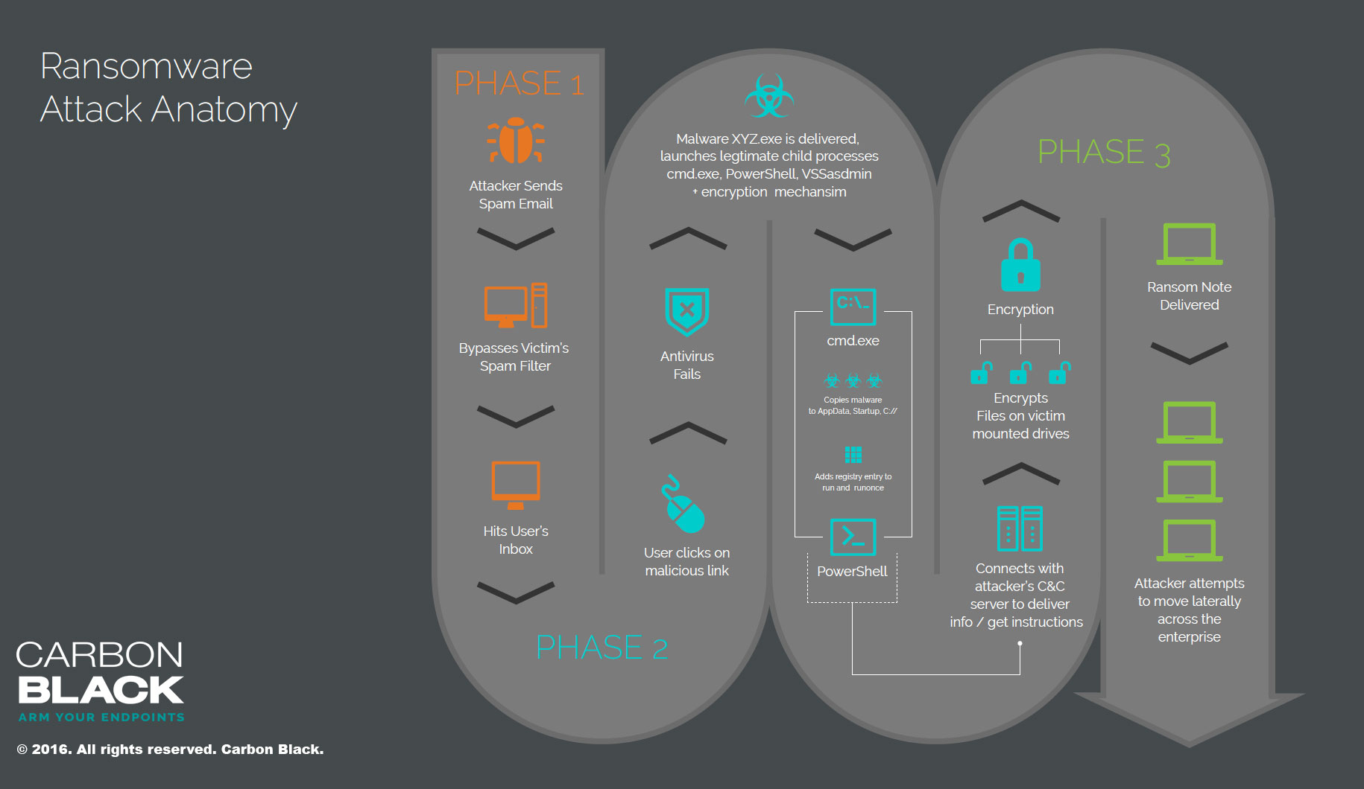

Slide 8
Types of Ransomware
Encryption Ransomware
Encrypts personal files/folders e.g , the contents of your My Documents folder- documents pictures videos etc.
Files are deleted once they are encrypted and a text file is present in the folder which is inaccessible.
Also called file encryption ransomware

Slide 9
Lock screen Ransomware
In this ransomware a screen is locked and payment is demanded
Presents a full screen image that blocks all other windows
This type is also called winlocker ransomware

Slide 10
Master Boot Record(MBR) Ransomware
The master boot record(MBR) is a section of the computer’s hard drive that allows the operating systems to boot up
MBR Ransomware changes the computer’s MBR so the normal boot process is interrupted.
A ransom demand is displayed on screen instead

Slide 11
Famous Ransomware
Wannacry: it was a cyber attack launched on may 12 2017
It happened after an Microsoft windows exploit(Eternel blue) was leaked by a group of hackers

Slide 12
CONCLUSION
When it comes to malware attack, knowledge is the best possible weapon to prevent them. Be careful what you click!!. Keeping all the software updated and getting latest security updates might help to prevent the attack.

Slide 13
Thank you

